Slide 1
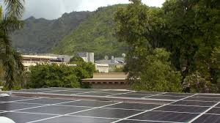
UH Manoa Energy & Demand
Miles Topping Jonathan Kutsunai

Slide 2
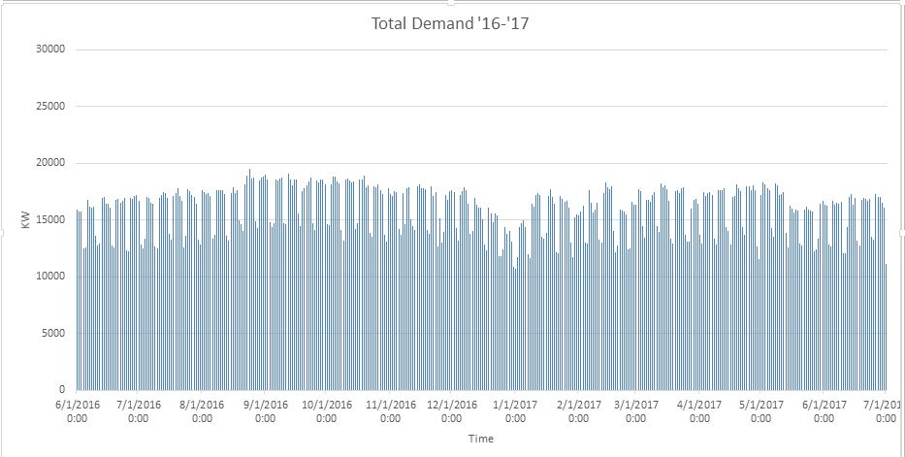
UH Manoa Total Demand
Highest Demand 8/24/17
Lowest Demand 1/1/2017
Max: 19504.08 KW (8/24/2016) Min: 8322.24 KW (1/1/2017) Mean: 15,920.5 KW (6/29/2017) Median: 16,534.8 KW (6/7/2016)
Mode: 16,139.52 KW (2/21/2017)

Slide 3
UH Manoa Demand Statistics
Average Peak Demand: 15,920 KW Timestamp: 12:30 PM
Highest Peak Demand: 19,504 KW Timestamp: 2:15 PM
Median Peak Demand: 16,534 KW Timestamp: 1:30 PM
Mode Peak Demand: 16,139 KW Timestamp: 12:15 PM
Lowest Peak Demand: 10,666 KW Timestamp: 6:45 PM
Statistic | Day | Highest Peak Demand (KW) | Timestamp of Peak Demand | Low Demand (KW) | Timestamp of Low Demand | Total Energy (MWH)
Max | 8/24/2016 | 19,504.08 | 2:15 PM | 11,529.36 | 1:30 AM | 380.94
Min | 1/1/2017 | 10,666.08 | 6:45 PM | 8,322.24 | 2:45 AM | 246.56
Median | 6/29/2017 | 16,534.8 | 1:30 PM | 11,034 | 4:00 AM | 328.05
Mode | 6/7/2016 | 16,139.52 | 12:15 PM | 11,308.32 | 4:15 AM | 317.42
Mean | 2/21/2017 | 15,920.5 | 12:30 PM | 10,228.32 | 11:30 PM | 324.24

Slide 4
Demand Statistics
Highest Peak Demand Value was found to be 19,504 KW and the profile of that day was plotted
Lowest Peak Demand Value was found to be 10,66.08 KW and the profile of that day was plotted
Average Demand Value was found to be 15,920.5 KW for all demand, and the profile of 2/21/2017 was plotted since it included this value
Median Demand Value was found to be 16,534.8 KW for all demand, and the profile of 6/29/2017 was plotted since it included this value
Mode Demand Value was found to be 16,139.52 KW for all demand, and the profile of 6/7/2016 was plotedd since it included this value

Slide 5
UH Manoa Energy Statistics
Highest Energy Profile: 380,945 KWH Timestamp: 24 Hr Period
Mode Energy Profile: 317,421 KWH Timestamp: 24 Hr Period
Lowest Energy Profile: 246,563 KWH Timestamp: 24 Hr Period
Median Energy Profile: 328,055 KWH Timestamp: 24 Hr Period
Statistic | Day | Total Energy MWH) | Highest Peak Demand (KW) | Timestamp of Peak Demand
Max | 8/24/2016 | 380.94 | 19,504.08 | 2:15 PM
Min | 1/1/2017 | 246.56 | 10,666.08 | 6:45 PM
Median | 6/29/2017 | 328.05 | 16,534.8 | 1:30 PM
Mode | 6/7/2016 | 317.42 | 16,139.52 | 12:15 PM
Mean | 2/21/2017 | 324.24 | 15,920.5 | 12:30 PM
Average Energy Profile: 324,244 KWH Timestamp: 24 Hr Period

Slide 6
Energy Statistics
Highest Amount of Energy was found to be 380,945.3 KWH and the profile of that day was plotted
Lowest Amount of Energy was found to be 246,563.2 KWH and the profile of that day was plotted
Average Energy was found to be 324,244.4 KWH and the profile of 2/21/2017
Median Energy was found to be 328,055 KWH and the profile of 6/29/2017
Mode Energy was found to be 317,421 KWH and the profile of 6/7/2016

Slide 7
UH Manoa Weekend Demand Statistics
Lowest Peak Demand: 10,666 KW Timestamp: 2:00 PM
Average Peak Demand: 13,288 KW Timestamp: 7:00 PM
Median Peak Demand: 13,272.84 KW Timestamp: 4:30 PM
Highest Peak Demand: 15,549 KW Timestamp: 11:45 AM
Mode Peak Demand: 12,820 KW Timestamp: 12:30 PM
Day | Day | Highest Peak Demand | Timestamp of Peak Demand | Low Demand | Timestamp of Low Demand | Total Energy (MWH)
Max | 9/17/2016 (Sat) | 15,549.84 KW | 11:15 AM | 11,458.08 KW | 11:15 PM | 330
Min | 1/1/2017 (Sun) | 10,666.08 KW | 2:00 PM | 8,337.6 KW | 5:30 AM | 246
Median | 2/11/2017 (Sat) | 13,288.28 KW | 7:00 PM | 11,052 KW | 4:00 AM | 293
Mode | 7/2/2016 (Sat) | 13,272.84 | 4:30 PM | 10,679.04 KW | 11:30 PM | 281
Mean | 1/15/17 (Sun) | 12,820 KW | 12:30 PM | 11,112.56 KW | 4:00 AM | 290

Slide 8
Weekend Demand Statistics
Highest Peak Demand Value was found to be 15,549 KW and the profile of that day was plotted
Lowest Peak Demand Value was found to be 10,666.08 KW and the profile of that day was plotted
Average Demand Value was found to be 13,288.28 KW for all demand, and the profile of 1/15/2016 was plotted since it included this value
Median Demand Value was found to be 13,272.84 KW for all demand, and the profile of 2/11/2017 was plotted since it included this value
Mode Demand Value was found to be 12,820 KW for all demand, and the profile of 7/2/2016 was plotted since it included this value

Slide 9
UH Manoa Sunday Demand Statistics
Day | Day | Highest Peak Demand | Timestamp of Peak Demand | Low Demand | Timestamp of Low Demand | Total Energy (MWH)
Max | 10/16/2016 | 14,729.76 | 6:30 PM | 11,399.76 | 4:30 AM | 314
Min | 1/1/2017 | 10,666.08 | 6:45 PM | 8,322.24 | 2:45 AM | 246
Median | 2/12/2017 | 13,056.12 | 6:15 PM | 10,592.64 | 2:00 AM | 289
Mode | 5/14/2017 | 12,562.56 | 7:00 PM | 10,790.64 | 4:00 AM | 280
Mean | 3/26/2017 | 13,100.4 | 1:15 PM | 10,836 | 2:30 AM | 289

Slide 10
Sunday Demand Statistics
Highest Peak Demand Value was found to be 14,729.76 KW and the profile of that day was plotted
Lowest Peak Demand Value was found to be 10,666.08 KW and the profile of that day was plotted
Average Demand Value was found to be 13,100.4 KW for all demand, and the profile of 10/30/2016 was plotted since it was closest to 13,288.24
Median Demand Value was found to be 13,056.12 KW for all demand, and the profile of 3/26/2017 was plotted since it was closest to 13,080.24
Mode Demand Value was found to be 12,500 KW, and the profile of 5/14/2017 was modeled since it included this value

Slide 11
Conclusions
Peak Demand and the total amount of energy used in a day are directly correlated
Weekends use significantly less energy then the weekdays (difference of 3,000-4,000 KW peaks)
Sundays tend to peak in the early evening, rather then in the afternoon

Slide 12
Comments
Possible causes of fluctuation:
A/C Usage (Greater number of cooling days)
Amount of people on campus utilizing resources
Lab Usage
Student Housing Remodeling/Conference Housing
Sundays: Peak in the evening due to everyone coming back to campus
12/31/16 and 1/1/17 did not have mid day rises, and according to historical weather data those days had almost all cloud cover/rain the entire day.
231 Days had a peak demand between the highest peak and the average value which explains why the average, median, and mode are higher then expected.
Notes:
A/C -Costs a lot of energy to operate, especially when constantly getting turned on/off -Being constantly on causes a strain and a loss of efficiency
-Leaks/condensation happen quicker
-Getting dirty/clogged happens quicker
Amount of people -Using more lights, computers, water, bathrooms -Higher in the school times (summer/fall) then the new year (holiday) Lab Usage -A/C -Hood vents to control air/environment -Hydraulics -All the meters -Higher in summer because there’s a greater concentration of students using lab more frequently Student Housing/ Conference Housing -Little concept of how much money it takes to run facilities -Summer there’s less people, but they care a lot less (leave lights on, a/c on, bathroom a lot more, etc.) -Noelani getting renovated -Frear Hall/Ilima treated like hotel
-Buildings under a lot of repair/old equipment

